Slide 1
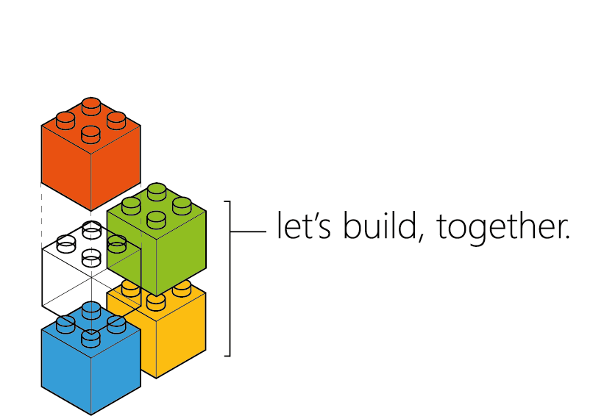
Crossing Boundaries
Joni Collinge
@dotjson

Slide 2
Roadmap
Microservices
Containerisation
Azure Container Service
Azure Service Fabric

Slide 3
Microservices
Why?

Slide 4
Monolith
Client
Full Stack App

Slide 5
Monolith
Client
Front End
Business Logic
Data

Slide 6
Monolith
Client
Front End
Business Logic
Data

Slide 7
Monolith
Client
Front End
Business Logic
Data

Slide 8

Monolith
Client
Front End
Business Logic
Data

Slide 9

Monolith
Client
Front End
Business Logic
Data

Slide 10
Microservices
Driver Management
Notifications
Client
Driver Web UI
Billing

Slide 11
Microservices
Driver Management
API
Notifications
Notifications
Client
Driver Web UI
API
Billing

Slide 12
Microservices
Driver Management
Data
API
Notifications
Notifications
Client
Driver Web UI
API
Data
Billing

Slide 13
Microservices
Driver Management
Data
API
Notifications
Notifications
Client
Driver Web UI
API
Data
Billing

Slide 14

Microservices
Driver Management
Data
API
Notifications
Notifications
Client
Driver Web UI
API
Data
Billing

Slide 15
Infrastructure
Monolith
Microservices

Slide 16
Dependencies
PHP
WebSockets
Apache
Node.js
Ubuntu
Monolith
Microservices

Slide 17
Isolating dependencies
Application
WebSockets 3.1.2
Node.js 1.0.0
Ubuntu 14.04
Microservices

Slide 18
Containerisation
Application
WebSockets 3.1.2
Container
Node.js 1.0.0
Ubuntu 14.04
Linux Kernel
Host
Microservices

Slide 19
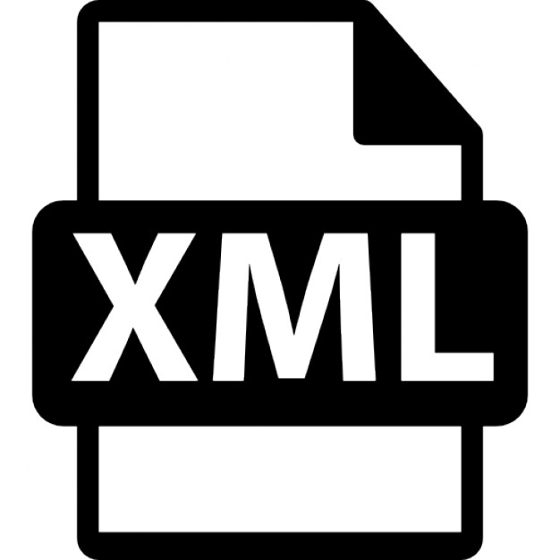

Containerisation
Application
Application 2
WebSockets 3.1.2
Java
Container
Node.js 1.0.0
Spring
Ubuntu 14.04
CentOS
Linux Kernel
Host

Slide 20
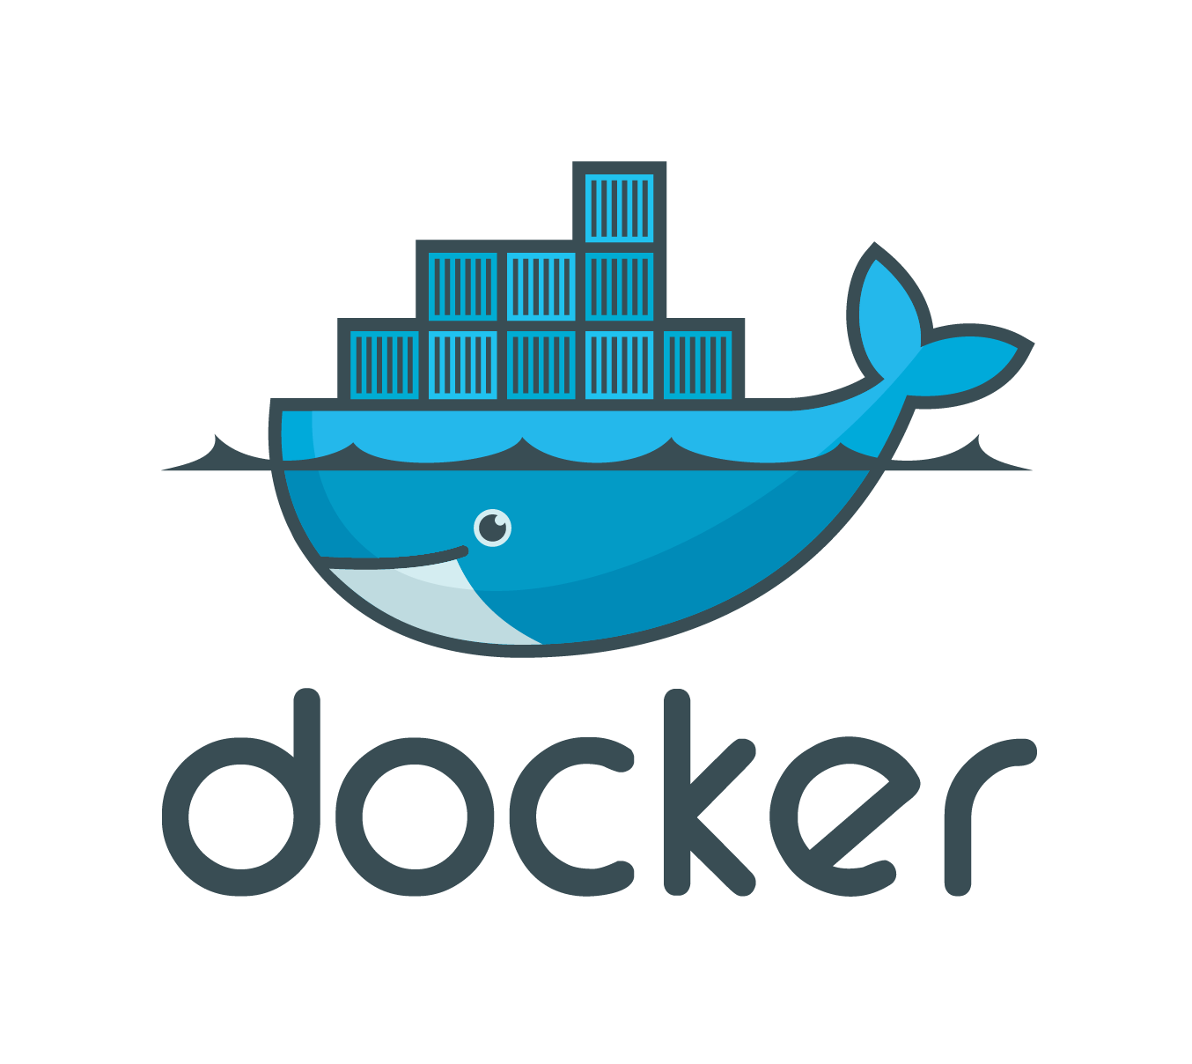

Slide 21
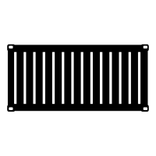
Docker ecosystem
Container Image
5001
Application
Dockerfile
WebSockets 3.1.2
Docker Engine
Node.js 1.0.0
YML
Ubuntu 14.04
Build
Docker Client

Slide 22
Docker ecosystem
Container Image
5001
Application
Should be immutable
Dockerfile
WebSockets 3.1.2
Docker Engine
Docker Hub
Node.js 1.0.0
YML
Ubuntu 14.04
Push
Docker Client

Slide 23
Docker Compose
Container Image 1
Docker-Compose
Container Image 2
YML
Requirements
Container Image 3
TXT

Slide 24
Orchestrators
Resource Pool
Resource Balancing
Cluster Manager
C
B
B
Fail Over
Schedulers
A
A
A
A
C
Service Discovery
Load Balancers
B
A

Slide 25
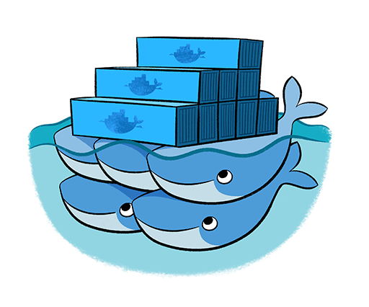

Azure Container Service
A hosted container services giving you scale, orchestration and optimisation.
Now Generally Available

Slide 26
Azure Container Service
Client
</>
Scheduler
Managers
Service Discovery
Nodes
Containers

Slide 27
Azure Container Service
Client
HTTP
Framework A
Master
Framework B
ZooKeeper
Slaves
Containers
Pod
Pods

Slide 28


Azure Service Fabric A platform for reliable, hyperscale, microservice-based applications
Your Microservices
Your Value
Service Fabric
Azure
Private cloud
Other clouds
Notes:
Microsoft Azure has been going through the transition of taking Tier 1 products such as SQL Server, Analysis Server, System center, Lync and running these as cloud services, as well as creating brand new “born in the cloud” Tier 1 services such as DocumentDB. In order to do this, we needed a new kind of PaaS, one that provides all the capabilities shown here such as high availability at scale, running at high density to reduce costs, agility in large development teams to be able to decompose the cloud service down into independent discrete smaller services each of which be partitioned for scale.
Importantly we realized that the largest cost for a cloud service was the day to day management and operation of the service, and not having to worry about the availability of the service in the event of machine, network, process failures. So, Service Fabric also provides a self-healing approach which means you do not need large teams of people to ensure that the service is always running. Equally with the concepts of application versioning, no downtime rolling upgrades and automatic service resource balancing based on current load and health, Service Fabric provides complete lifecycle support for your cloud service.
Service Fabric will be available in Azure as a service and in Windows Server 2016. Applications built against the programming APIs can be deployed to any of these environments with no code changes. Currently, as you would expect given that we developed Service Fabric for our own services, it runs on Windows, but we have started the port on Linux that we will eventually release.
The world is changing for you as developers, as previous on-premise products move the cloud as services to take advantage of utility computing and global reach. You need a platform that helps get you there. Now you can use the same platform that Azure is using for its tier 1 services and all this is installed on your laptop. You have a whole data center in your hands.
*****************************************************************************
Service Fabric is aproven distributed systems platform that:
Makes it easy to build scalable and reliable services
Allows keeping compute and associated state together to achieve high throughput and low latency
Manages full service lifecycle
Can be deployed in-cloud or on-premises

Slide 29
Service Fabric services
Cluster Manager
Performs cluster operations
Failover Manager
Rebalances resources as nodes come/go
Naming Service
Maps service instances to endpoints
Image Store (Not on *OneBox)
Contains your application packages
Upgrade Service (Azure ONLY)
Coordinates upgrading SF itself with Azure’s SFRP
*OneBox is local dev deployment

Slide 30
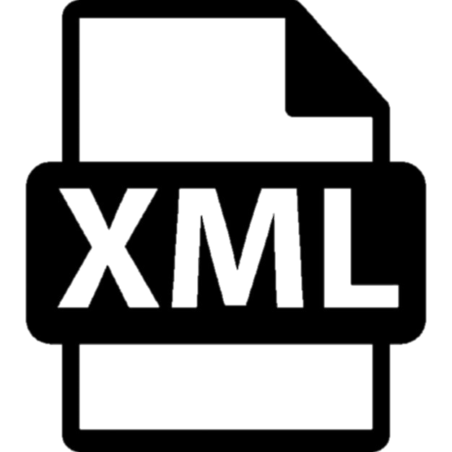

Application packages
Service A
Manifest
Code
App
Code
.CS
Config
Data
Service B
Manifest
Code
.CS

Slide 31
Programming models
Reliable Services
Reliable collection (Dictionary and Queue) classes to persist state.
Full control of concurrency and state management.
ALM benefits
Reliable Actors
Many small independent units of state (i.e. sensor, smart car, etc.)
Single threaded objects
Service Fabric manages concurrency, granularity of state and communication
STATELESS STATEFUL
*Stateful service’s state is serialised and stored on the nodes not in a database.
Notes:
Actor model simplifies the complexity of programming against distributed, concurrent systems and speed up development etc.
Services is an on boarding approach to microservices for running web services, windows services.

Slide 32
Microservices
Driver Web UI
Data
API
Notifications
Notifications
Client
Gateway
API
Data
Driver Management

Slide 33
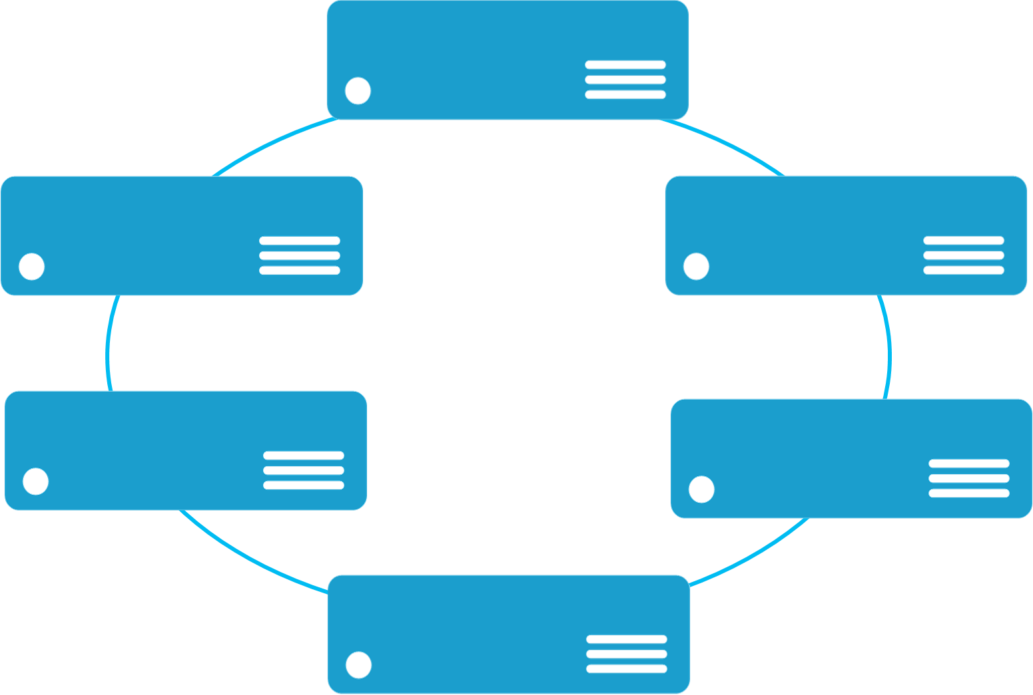
Service Fabric cluster
The runtime environment your microservices run on top of
UD/FD Isolation
Microservices
Nodes
SF
SF
SF
Cluster
SF
SF
+
= App1
SF
+
+
= App2
Notes:
Explain how the cluster works
SHOW EXPLORER

Slide 34
Service Fabric cluster
The runtime environment your microservices run on top of
UD/FD Isolation
Microservices
Nodes
SF
SF
SF
Cluster
SF
SF
+
= App1
SF
+
+
= App2
Notes:
Explain how the cluster works
SHOW EXPLORER

Slide 35

Service Fabric cluster
: Stateful service
The runtime environment your microservices run on top of
UD/FD Isolation
Microservices
Nodes
SF
SF
SF
Cluster
WRITE
SF
S
SF
P
+
= App1
S
SF
+
+
= App2
Notes:
Explain how the cluster works
SHOW EXPLORER

Slide 36
DEMO
Azure
Service Fabric
Phone Actors
…
Aggregation Service
Web Front End
Notes:
Show in browser demo of nodes and relationships growing
Show IoT hub message stats

Slide 37
Recap
Microservices
Containerisation
Azure Container Service
Azure Service Fabric

Slide 38



Call to action
Introduction to Microservices
https://www.nginx.com/blog/introduction-to-microservices/
Introduction to Service Fabric
https://azure.microsoft.com/en-gb/documentation/learning-paths/service-fabric/
Building Microservices: Designing Fine Grained Systems
Sam Newman
Joni Collinge
@dotjson

